Slide 1
Chapter 5
Large and Fast: Exploiting Memory Hierarchy
Notes:
Morgan Kaufmann Publishers
Chapter 5 — Large and Fast: Exploiting Memory Hierarchy

Slide 2
Principle of Locality
§5.1 Introduction
Programs access a small proportion of their address space at any time
Temporal locality
  Items accessed recently are likely to be accessed again soon
  e.g., instructions in a loop, induction variables
Spatial locality
  Items near those accessed recently are likely to be accessed soon
  E.g., sequential instruction access, array data
Chapter 5 — Large and Fast: Exploiting Memory Hierarchy — <number>
Notes:
Morgan Kaufmann Publishers
Chapter 5 — Large and Fast: Exploiting Memory Hierarchy

Slide 3

Memory Hierarchy Levels
Block (aka line): unit of copying
  May be multiple words
If accessed data is present in upper level
  Hit: access satisfied by upper level
    Hit ratio: hits/accesses
If accessed data is absent
  Miss: block copied from lower level
    Time taken: miss penalty
    Miss ratio: misses/accesses
    = 1 – hit ratio
  Then accessed data supplied from upper level
Chapter 5 — Large and Fast: Exploiting Memory Hierarchy — <number>
Notes:
Morgan Kaufmann Publishers
Chapter 5 — Large and Fast: Exploiting Memory Hierarchy

Slide 4
Memory Technology
Static RAM (SRAM)
  0.5ns – 2.5ns, $2000 – $5000 per GB
Dynamic RAM (DRAM)
  50ns – 70ns, $20 – $75 per GB
Magnetic disk
  5ms – 20ms, $0.20 – $2 per GB
Ideal memory
  Access time of SRAM
  Capacity and cost/GB of disk
§5.2 Memory Technologies
Chapter 5 — Large and Fast: Exploiting Memory Hierarchy — <number>
Notes:
Morgan Kaufmann Publishers
Chapter 5 — Large and Fast: Exploiting Memory Hierarchy

Slide 5

Cache Memory
Cache memory
  The level of the memory hierarchy closest to the CPU
Given accesses X₁, …, X_{n–1}, X_{n}
§5.3 The Basics of Caches
How do we know if the data is present?
Where do we look?
Chapter 5 — Large and Fast: Exploiting Memory Hierarchy — <number>
Notes:
Morgan Kaufmann Publishers
Chapter 5 — Large and Fast: Exploiting Memory Hierarchy

Slide 6

Direct Mapped Cache
Location determined by address
Direct mapped: only one choice
  (Block address) modulo (#Blocks in cache)
#Blocks is a power of 2
Use low-order address bits
Chapter 5 — Large and Fast: Exploiting Memory Hierarchy — <number>
Notes:
Morgan Kaufmann Publishers
Chapter 5 — Large and Fast: Exploiting Memory Hierarchy

Slide 7
Tags and Valid Bits
How do we know which particular block is stored in a cache location?
  Store block address as well as the data
  Actually, only need the high-order bits
  Called the tag
What if there is no data in a location?
  Valid bit: 1 = present, 0 = not present
  Initially 0
Chapter 5 — Large and Fast: Exploiting Memory Hierarchy — <number>
Notes:
Morgan Kaufmann Publishers
Chapter 5 — Large and Fast: Exploiting Memory Hierarchy

Slide 8
Cache Example
8-blocks, 1 word/block, direct mapped
Initial state
Index | V | Tag | Data
000 | N
001 | N
010 | N
011 | N
100 | N
101 | N
110 | N
111 | N
Chapter 5 — Large and Fast: Exploiting Memory Hierarchy — <number>
Notes:
Morgan Kaufmann Publishers
Chapter 5 — Large and Fast: Exploiting Memory Hierarchy

Slide 9
Cache Example
Word addr | Binary addr | Hit/miss | Cache block
22 | 10 110 | Miss | 110
Index | V | Tag | Data
000 | N
001 | N
010 | N
011 | N
100 | N
101 | N
110 | Y | 10 | Mem[10110]
111 | N
Chapter 5 — Large and Fast: Exploiting Memory Hierarchy — <number>
Notes:
Morgan Kaufmann Publishers
Chapter 5 — Large and Fast: Exploiting Memory Hierarchy

Slide 10
Cache Example
Word addr | Binary addr | Hit/miss | Cache block
26 | 11 010 | Miss | 010
Index | V | Tag | Data
000 | N
001 | N
010 | Y | 11 | Mem[11010]
011 | N
100 | N
101 | N
110 | Y | 10 | Mem[10110]
111 | N
Chapter 5 — Large and Fast: Exploiting Memory Hierarchy — <number>
Notes:
Morgan Kaufmann Publishers
Chapter 5 — Large and Fast: Exploiting Memory Hierarchy

Slide 11
Cache Example
Word addr | Binary addr | Hit/miss | Cache block
22 | 10 110 | Hit | 110
26 | 11 010 | Hit | 010
Index | V | Tag | Data
000 | N
001 | N
010 | Y | 11 | Mem[11010]
011 | N
100 | N
101 | N
110 | Y | 10 | Mem[10110]
111 | N
Chapter 5 — Large and Fast: Exploiting Memory Hierarchy — <number>
Notes:
Morgan Kaufmann Publishers
Chapter 5 — Large and Fast: Exploiting Memory Hierarchy

Slide 12
Cache Example
Word addr | Binary addr | Hit/miss | Cache block
16 | 10 000 | Miss | 000
3 | 00 011 | Miss | 011
16 | 10 000 | Hit | 000
Index | V | Tag | Data
000 | Y | 10 | Mem[10000]
001 | N
010 | Y | 11 | Mem[11010]
011 | Y | 00 | Mem[00011]
100 | N
101 | N
110 | Y | 10 | Mem[10110]
111 | N
Chapter 5 — Large and Fast: Exploiting Memory Hierarchy — <number>
Notes:
Morgan Kaufmann Publishers
Chapter 5 — Large and Fast: Exploiting Memory Hierarchy

Slide 13
Cache Example
Word addr | Binary addr | Hit/miss | Cache block
18 | 10 010 | Miss | 010
Index | V | Tag | Data
000 | Y | 10 | Mem[10000]
001 | N
010 | Y | 10 | Mem[10010]
011 | Y | 00 | Mem[00011]
100 | N
101 | N
110 | Y | 10 | Mem[10110]
111 | N
Chapter 5 — Large and Fast: Exploiting Memory Hierarchy — <number>
Notes:
Morgan Kaufmann Publishers
Chapter 5 — Large and Fast: Exploiting Memory Hierarchy

Slide 14

Address Subdivision
Chapter 5 — Large and Fast: Exploiting Memory Hierarchy — <number>
Notes:
Morgan Kaufmann Publishers
Chapter 5 — Large and Fast: Exploiting Memory Hierarchy

Slide 15
Example: Larger Block Size
64 blocks, 16 bytes/block
  To what block number does byte address 1200 map?
Block address = ⎣1200/16⎦ = 75
Block number = 75 modulo 64 = 11
31
10
9
4
3
0
Tag
Index
Offset
22 bits
6 bits
4 bits
Chapter 5 — Large and Fast: Exploiting Memory Hierarchy — <number>
Notes:
Morgan Kaufmann Publishers
Chapter 5 — Large and Fast: Exploiting Memory Hierarchy

Slide 16

Chapter 5 — Large and Fast: Exploiting Memory Hierarchy — <number>

Slide 17
Cache Misses
On cache hit, CPU proceeds normally
On cache miss
  Stall the CPU pipeline
  Fetch block from next level of hierarchy
Chapter 5 — Large and Fast: Exploiting Memory Hierarchy — <number>
Notes:
Morgan Kaufmann Publishers
Chapter 5 — Large and Fast: Exploiting Memory Hierarchy

Slide 18
Write-Through
On data-write hit, could just update the block in cache
  But then cache and memory would be inconsistent
Write through: also update memory
But makes writes take longer
Chapter 5 — Large and Fast: Exploiting Memory Hierarchy — <number>
Notes:
Morgan Kaufmann Publishers
Chapter 5 — Large and Fast: Exploiting Memory Hierarchy

Slide 19
Write-Back
Alternative: On data-write hit, just update the block in cache
  Keep track of whether each block is dirty
When a dirty block is replaced
  Write it back to memory
  Can use a write buffer to allow replacing block to be read first
Chapter 5 — Large and Fast: Exploiting Memory Hierarchy — <number>
Notes:
Morgan Kaufmann Publishers
Chapter 5 — Large and Fast: Exploiting Memory Hierarchy

Slide 20
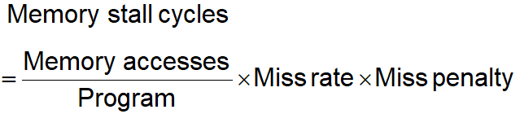
Measuring Cache Performance
Components of CPU time
  Program execution cycles
    Includes cache hit time
  Memory stall cycles
    Mainly from cache misses
With simplifying assumptions:
§5.4 Measuring and Improving Cache Performance
Chapter 5 — Large and Fast: Exploiting Memory Hierarchy — <number>
Notes:
Morgan Kaufmann Publishers
Chapter 5 — Large and Fast: Exploiting Memory Hierarchy

Slide 21
Associative Caches
Fully associative
  Allow a given block to go in any cache entry
  Requires all entries to be searched at once
  Comparator per entry (expensive)
n-way set associative
  Each set contains n entries
  Block number determines which set
    (Block number) modulo (#Sets in cache)
  Search all entries in a given set at once
  n comparators (less expensive)
Chapter 5 — Large and Fast: Exploiting Memory Hierarchy — <number>
Notes:
Morgan Kaufmann Publishers
Chapter 5 — Large and Fast: Exploiting Memory Hierarchy

Slide 22

Associative Cache Example
Chapter 5 — Large and Fast: Exploiting Memory Hierarchy — <number>
Notes:
Morgan Kaufmann Publishers
Chapter 5 — Large and Fast: Exploiting Memory Hierarchy

Slide 23
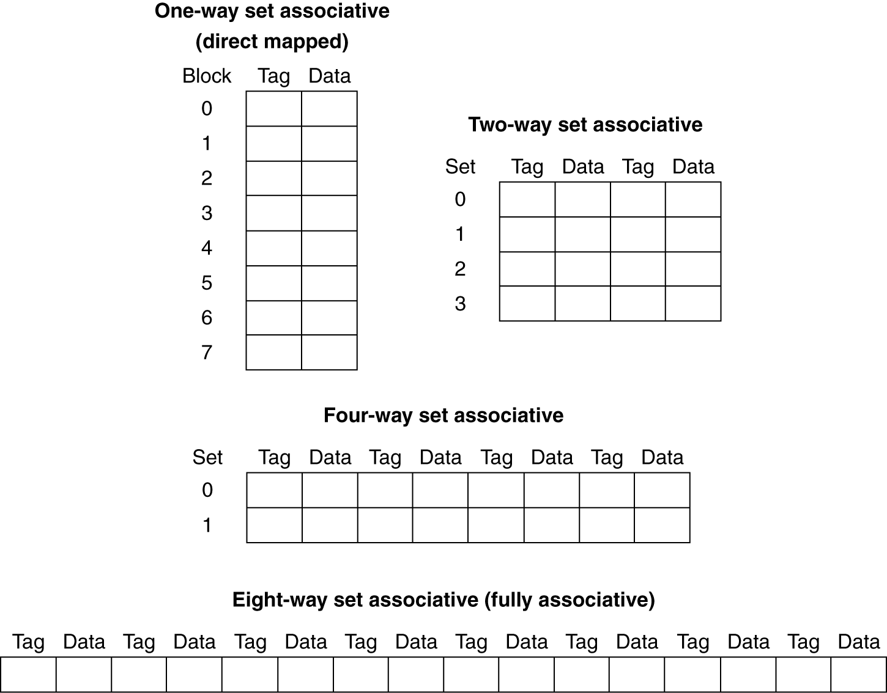
Spectrum of Associativity
For a cache with 8 entries
Chapter 5 — Large and Fast: Exploiting Memory Hierarchy — <number>
Notes:
Morgan Kaufmann Publishers
Chapter 5 — Large and Fast: Exploiting Memory Hierarchy

Slide 24
Associativity Example
Compare 4-block caches
  Direct mapped, 2-way set associative,
  fully associative
  Block access sequence: 0, 8, 0, 6, 8
Direct mapped
Block address | Cache index | Hit/miss | Cache content after access
 |  |  | 0 | 1 | 2 | 3
0 | 0 | miss | Mem[0]
8 | 0 | miss | Mem[8]
0 | 0 | miss | Mem[0]
6 | 2 | miss | Mem[0] |  | Mem[6]
8 | 0 | miss | Mem[8] |  | Mem[6]
Chapter 5 — Large and Fast: Exploiting Memory Hierarchy — <number>
Notes:
Morgan Kaufmann Publishers
Chapter 5 — Large and Fast: Exploiting Memory Hierarchy

Slide 25
Associativity Example
2-way set associative
Block address | Cache index | Hit/miss | Cache content after access
 |  |  | Set 0 |  | Set 1
0 | 0 | miss | Mem[0]
8 | 0 | miss | Mem[0] | Mem[8]
0 | 0 | hit | Mem[0] | Mem[8]
6 | 0 | miss | Mem[0] | Mem[6]
8 | 0 | miss | Mem[8] | Mem[6]
Fully associative
Block address |  | Hit/miss | Cache content after access
0 |  | miss | Mem[0]
8 |  | miss | Mem[0] | Mem[8]
0 |  | hit | Mem[0] | Mem[8]
6 |  | miss | Mem[0] | Mem[8] | Mem[6]
8 |  | hit | Mem[0] | Mem[8] | Mem[6]
Chapter 5 — Large and Fast: Exploiting Memory Hierarchy — <number>
Notes:
Morgan Kaufmann Publishers
Chapter 5 — Large and Fast: Exploiting Memory Hierarchy

Slide 26
How Much Associativity
Increased associativity decreases miss rate
  But with diminishing returns
Simulation of a system with 64KB
D-cache, 16-word blocks, SPEC2000
  1-way: 10.3%
  2-way: 8.6%
  4-way: 8.3%
  8-way: 8.1%
Chapter 5 — Large and Fast: Exploiting Memory Hierarchy — <number>
Notes:
Morgan Kaufmann Publishers
Chapter 5 — Large and Fast: Exploiting Memory Hierarchy

Slide 27

Set Associative Cache Organization
Chapter 5 — Large and Fast: Exploiting Memory Hierarchy — <number>
Notes:
Morgan Kaufmann Publishers
Chapter 5 — Large and Fast: Exploiting Memory Hierarchy

Slide 28
Replacement Policy
Direct mapped: no choice
Set associative
  Prefer non-valid entry, if there is one
  Otherwise, choose among entries in the set
Least-recently used (LRU)
  Choose the one unused for the longest time
    Simple for 2-way, manageable for 4-way, too hard beyond that
Random
  Gives approximately the same performance as LRU for high associativity
Chapter 5 — Large and Fast: Exploiting Memory Hierarchy — <number>
Notes:
Morgan Kaufmann Publishers
Chapter 5 — Large and Fast: Exploiting Memory Hierarchy

Slide 29
Multilevel Caches
Primary cache attached to CPU
  Small, but fast
Level-2 cache services misses from primary cache
  Larger, slower, but still faster than main memory
Main memory services L-2 cache misses
Some high-end systems include L-3 cache
Chapter 5 — Large and Fast: Exploiting Memory Hierarchy — <number>
Notes:
Morgan Kaufmann Publishers
Chapter 5 — Large and Fast: Exploiting Memory Hierarchy

Slide 30
Handling Cache Misses (Miss penalty)
Send the original PC value (current PC – 4) to the memory.
Instruct main memory to perform a read and wait for the memory to complete its access (significant processor cycles).
Write the cache entry, putting the data from memory in the data portion of the entry, writing the upper bits of the address (from the ALU) into the tag field, and turning the valid bit on.
Restart the instruction execution at the first step, which will re-fetch the instruction, this time finding it in the cache.

Slide 31
Concepts and Terminologies
A memory hierarchy can consist of multiple levels, but data is copied between only two adjacent levels at a time.
Direct-Mapped cache: A cache structure in which each memory location is mapped to exactly one location in the cache.
Tag: A field in a table used for a memory hierarchy that contains the address information required to identify whether the associated block in the hierarchy corresponds to a requested word.
Valid Bit: A field in the tables of a memory hierarchy that indicates that the associated block in the hierarchy contains valid data.

Slide 32
Concepts and Terminologies (Contd.)
Hit: If the data requested by the processor appears in some block in the upper level, this is called a hit.
Miss: If the data is not found in the upper level, the request is called a miss. The lower level in the hierarchy is then accessed to retrieve the block containing the requested data.
Hit rate: The fraction of memory accesses found in a level of the memory hierarchy.
Miss rate: The fraction of memory accesses not found in a level of the memory hierarchy.

Slide 33
Concepts and Terminologies (Contd.)
Hit Time: The time required to access a level of the memory hierarchy, including the time needed to determine whether the access is a hit or a miss.
Miss Penalty: The time required to fetch a block into a level of the memory hierarchy from the lower level, including the time to access the block, transmit it from one level to the other, insert it in the level that experienced the miss, and then pass the block to the requestor.

Slide 34
Cache Performance
CPU time = (CPU execution clock cycles + Memory-stall clock cycles) x Clock cycle time

Slide 35
Miss Rate vs Block Size
Increasing the block size usually decreases the miss rate.
The miss rate may go up eventually if the block size becomes a significant fraction of the cache size, because the number of blocks that can be held in the cache will become small, and there will be a great deal of competition for those blocks.
The miss penalty is determined by the time required to fetch the block from the next lower level of the hierarchy and load it into the cache.
The time to fetch the block has two parts: the latency to the first word and the transfer time for the rest of the block.
The transfer time will likely increase as the block size increases.
The improvement in the miss rate starts to decrease as the blocks become larger.

Slide 36
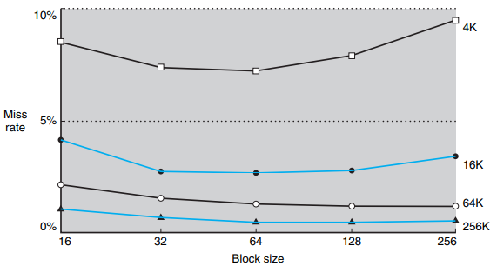
Miss Rate vs Block Size (Contd.)

Slide 37
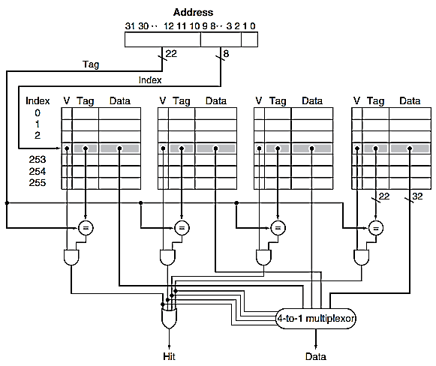
Four-Way Set-Associative Cache
Related Concepts:
Locating a block
Choosing which block to replace: least recently used

Slide 38
Reducing the Miss Penalty Using Multilevel Caches
Multilevel Cache: A memory hierarchy with multiple levels of caches, rather than just a cache and main memory.
Cache Miss on Level 1 → Find the data in Level 2 Cache

Slide 39
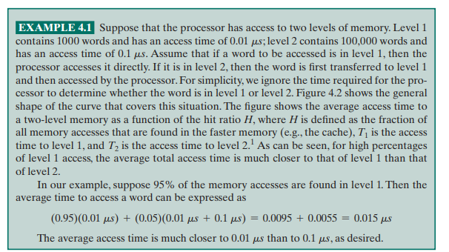
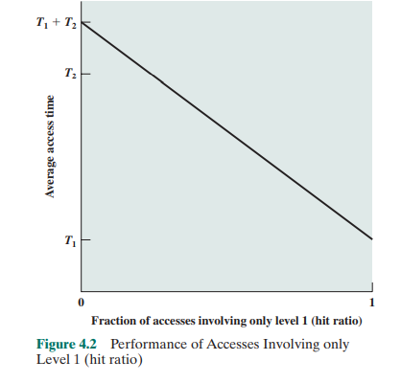
Average Access Time

Slide 40
Average Access Time
Question:
Consider a 3 level memory. It takes 0.001us to read from level 1, 0.01us to read from level 2 and 0.1us from level 3.
Data is found in L1 80% of time, out the remaining 20% of time 15% it is found in L2 and 5% data is to be read from L3.
What is the average access time?

Slide 41
Average Access Time
Question:
  Consider a 3 level memory. It takes 0.001us to read from level 1, 0.01us to read from level 2 and 0.1us from level 3.
  Data is found in L1 80% of time, out the remaining 20% of time 15% it is found in L2 and 5% data is to be read from L3.
  What is the average access time?
Answer:
Average Access time= 80%(0.001)+ 15%(0.01+0.001)+ 5%(0.1+0.01+0.001)=0.008

Slide 42
EXERCISE

Slide 43
Question
Consider a cache that can store 4 words,
Consider a Main Memory of 64 words
For the following addresses of RAM accesses, find the hits and misses using direct mapping:
  10,12,10,12,63,58,34,10,34,63, 33,10, 63

Slide 44
Question
Consider a cache that can store 4 words,
Consider a Main Memory of 64 words
LRU is used as replacement policy.
For the following addresses of RAM accesses, find the hits and misses using associative mapping:
  10,12,10,12,63,58,34,10,34,63, 33,10, 63

Slide 45
Question
Consider a cache that can store 4 words,
Consider a Main Memory of 64 words
LRU is used as replacement policy.
For the following addresses of RAM accesses, find the hits and misses using 2 way set associative mapping:
  10,12,10,12,63,58,34,10,34,63,33,10, 63

Slide 46
Concluding Remarks
Fast memories are small, large memories are slow
  We really want fast, large memories ☹
  Caching gives this illusion ☺
Principle of locality
  Programs use a small part of their memory space frequently
Memory system design is critical for multiprocessors
§5.16 Concluding Remarks
Chapter 5 — Large and Fast: Exploiting Memory Hierarchy — <number>
Notes:
Morgan Kaufmann Publishers
Chapter 5 — Large and Fast: Exploiting Memory Hierarchy

